Slide 1
HOTEL BOOKING ANALYSIS
PRESENTED BY :
Nisha Deepak Ingle

Slide 2
Problem Statement
The hotel reservation online system have drastically changed the booking possibilities and customer’s behaviour.
The typical reasons for cancelling the reservation is either change of plans or schedule problems.
It is easier for the guests to cancel the reservation but it is less desirable and problematic for the hotel

Slide 3
Objective:
Hotel Industry is the most volatile industry and the booking depends on the various factors.
Our data contains 36275 values and 19 columns.
The objective of this project is to explore and analyze the data to check predict if the customer is going to honor the reservation or cancel it

Slide 4
Data Description to understand the variables
Booking_ID: unique identifier of each booking
no_of_adults: Number of adults
no_of_children: Number of Children
no_of_weekend_nights: Number of weekend nights (Saturday or Sunday) the guest stayed or booked to stay at the hotel
no_of_week_nights: Number of week nights (Monday to Friday) the guest stayed or booked to stay at the hotel
type_of_meal_plan: Type of meal plan booked by the customer:
required_car_parking_space: Does the customer require a car parking space
room_type_reserved: Type of room reserved by the customer.
lead_time: Number of days between the date of booking and the arrival date
arrival_year: Year of arrival date
arrival_month: Month of arrival date
arrival_date: Arrival date of the month

Slide 5
market_segment_type: Market segment designation.
repeated_guest: Is the customer a repeated guest?
no_of_previous_cancellations: Number of previous bookings that were canceled by the customer prior to the current booking
no_of_previous_bookings_not_canceled: Number of previous bookings not canceled by the customer prior to the current booking
avg_price_per_room: Average price per day of the reservation; prices of the rooms are dynamic. (in euros)
no_of_special_requests: Total number of special requests made by the customer (e.g. high floor, view from the room, etc)
booking_status: Flag indicating if the booking was canceled or not.

Slide 6
Steps for Model Building
Define the data
Importing libraries
EDA (Exploratory Data Analysis)
Feature Engineering
Train-Test splitting
Model building on training Data
Model Evaluation
Model Optimization

Slide 7
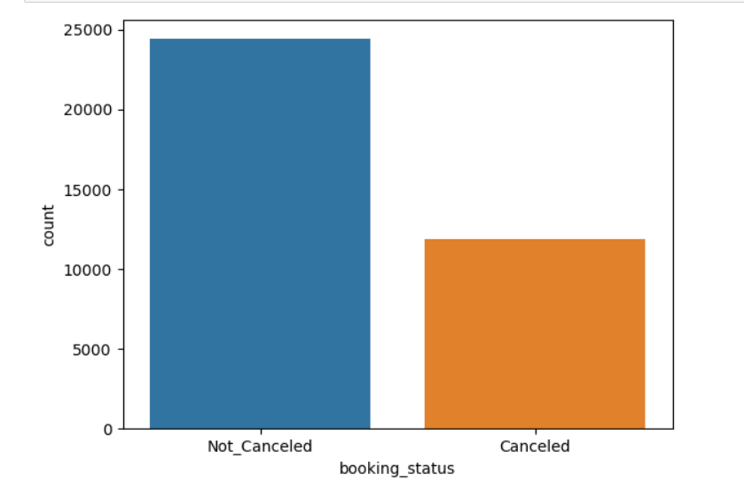
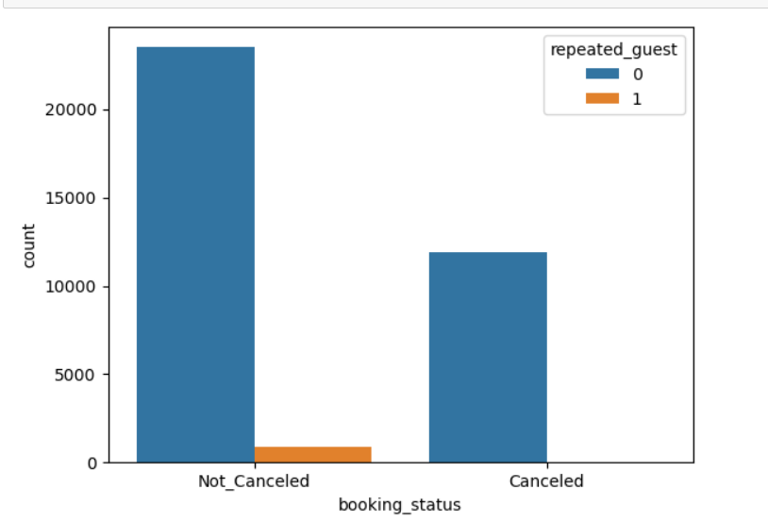
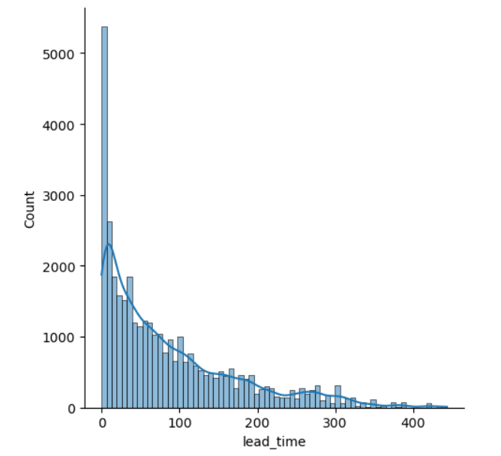
EDA (Exploratory Data Analysis)
EDA includes:
Understanding the variables.
Cleaning Data
Visualization of Data
Analyzing Relationship between Data

Slide 8
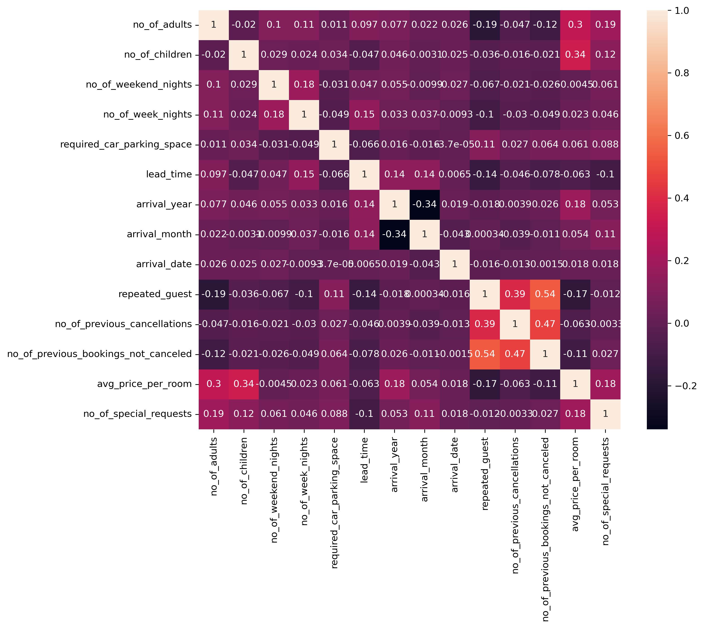
Correlation We can see that we don't have strong correlation between the variables.

Slide 9
Feature Engineering
Feature Engineering done in the project includes:
Encoding to convert categorical to numeric.
Feature Scaling
Balancing Target Variable

Slide 10
Model Building
Defining x and y
Splitting the data
Training and testing the data
Trained the algorithm on training data
Prediction is done on testing data

Slide 11
Model Evaluation
Since our problem is classification problem, here performance metrics are :
Confusion Matrix, which includes
Accuracy
Precision
Recall
TPR,FPR
ROC

Slide 12
Model Optimization
Hyperparameter tuning: Hyper parameter tuning is used to improve the accuracy of the machine learning model.
the main approach to machine learning optimization include: GridSearch or RandomSearch

Slide 13
Conclusion As we can see, the Random Forest and XGBoost models are the best for the model.
Algorithm and their accuracy score
Accuracy scores for each of the models when running on the train/test data split are as followed:
Logistic Regression = 75 %
Decision Tree = 86 %, after hyperparameter tuning = 87 %
Random Forest = 90 %, after hyperparameter tuning = 90 %
XGBoost = 88 %, after hyperparameter tuning = 91%

Slide 14
THANK YOU

